Slide 1

Document Object Model (DOM)‏
By
D.Chomaskandar
Chipkidz

Slide 2
Outline
Introduction of DOM
W3C
Overview of DOM
DOM Examples
How the DOM Really works?
Advantages and Disadvantages
DOM or SAX
Summary

Slide 3
Introduction of DOM

Slide 4
Before going to the DOM
HTML –How to Display the Data in the Webpage.
XML – How to Describe the Data .
DHTML- How to Add Movement or Animation to an HTML Document.
JAVASCRIPT- How to make Web Content Dynamic.

Slide 5
World Wide Web Consortium-W3C

Slide 6
World Wide Web Consortium-W3C
To Promote Open Standard For world wide web.
W3C is a vendor Organization.
Main Vendors are Netscape and Microsoft.
Some W3C Standards are HTTP,HTML,XML,CSS.
DOM is also Recommend by W3C.

Slide 7
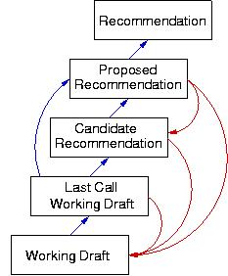
W3C

Slide 8

Five Basic Levels Of W3C :
Recommendation:- It is the Final outcome from W3C.All the Web functions are working properly.
HTML,CSS,DOM
No Error

Slide 9
Proposed Recommendation:-
In this layer the work is mostly complete .But some minor changes is occur.
Partial Output

Slide 10
Candidate Recommendation:-
MOZILLA
Not Working
Document.all
Document.all
MICROSOFT
IE
Working

Slide 11

Working Drafts
W3C
MEMBERS
Working With Current Task.

Slide 12
What is the DOM?
DOM
NEUTRAL - INTERFACE
HTML
XML
JAVA
SCRIPT
ANY
LANGUAGE

Slide 13
Status Of The DOM

Slide 14
DOM Level 1:
W3C recommendation, 1 Oct. 1998.
  Interfaces for representing an XML and HTML document.
  1)Document
  2)Node
  3)Attr
  4)Element
  5)and Text interfaces.

Slide 15
DOM Level 2:
W3C recommendation, 13 Nov. 2000.
  It contains six different specifications:
  1)DOM2 Core
  2)Views
  3)Events
  4)Style
  5)Traversal and Range
  6)and the DOM2 HTML.

Slide 16
DOM Level 3:
W3C candidate recommendation, 7 Nov. 2003
It contains five different specifications:
  1)DOM3 Core
  2)Load and Save
  3) Validation
  4)Events
  5)and XPath

Slide 17
Overview of DOM

Slide 18
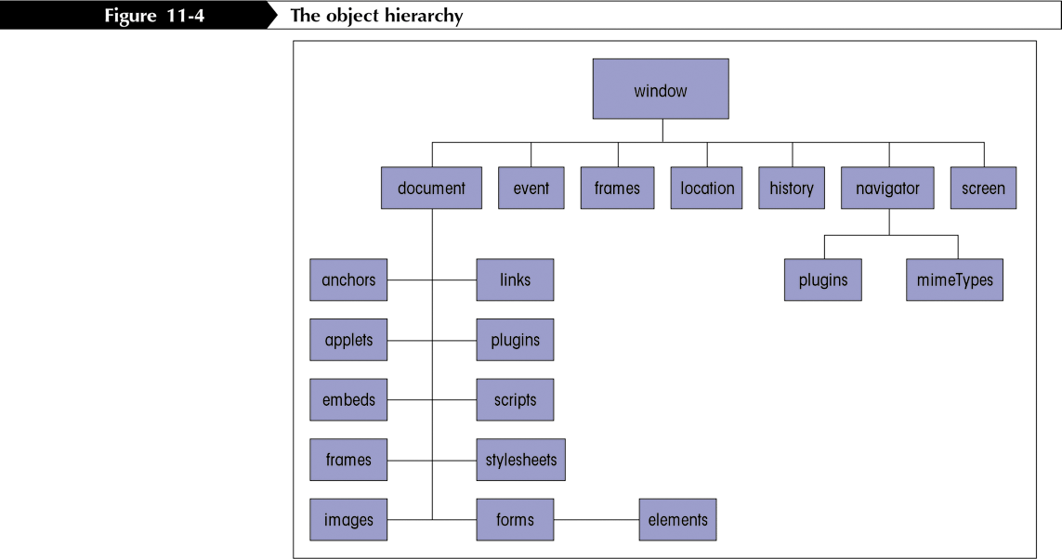
The Document Tree

Slide 19
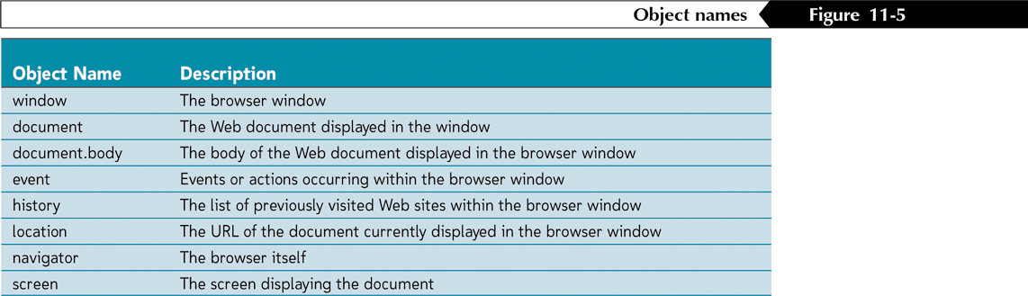
Referencing Objects-Each Object is Identified by Object Name.

Slide 20
How To Use Referencing Objects
Object Names
  General form is
  TO Access The History
  To Access The Body
  object1.object2.object3..
  window.history
  document.body

Slide 21
The DOM structure model
It is a Hierarchy of Node objects
  node object
    Element
    Attribute
    etc

Slide 22
The DOM Interface
The DOM has many interfaces to handle various node objects.
Every interface has its “Attributes” and “Methods”.
  Compare with Object Oriented Programming (OOP).
DOM
OOP
Interface
Object Class
Attribute
Property
Method
Method

Slide 23
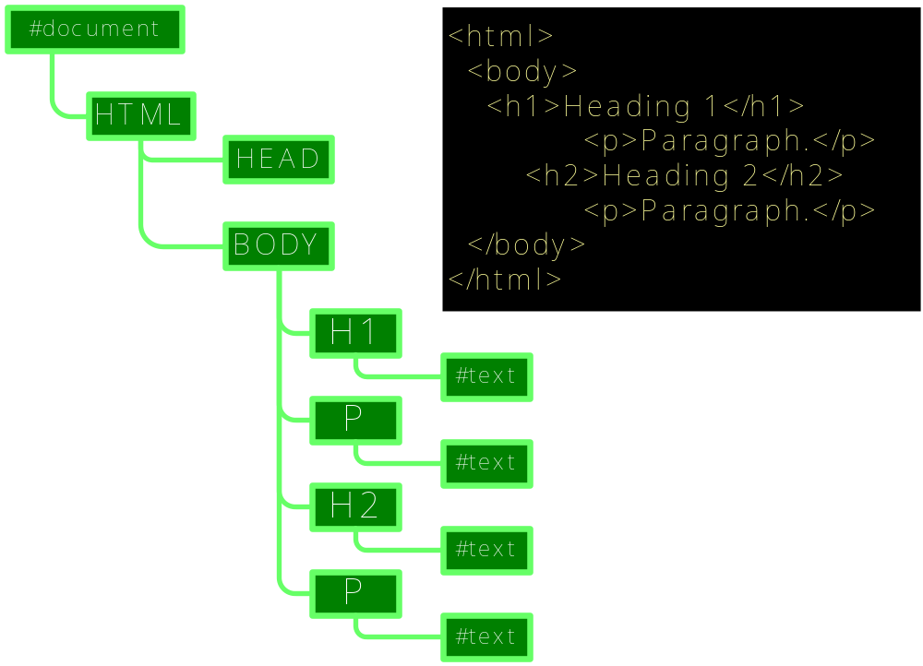
Document Tree Structure
document
document.
documentElement
document.body

Slide 24

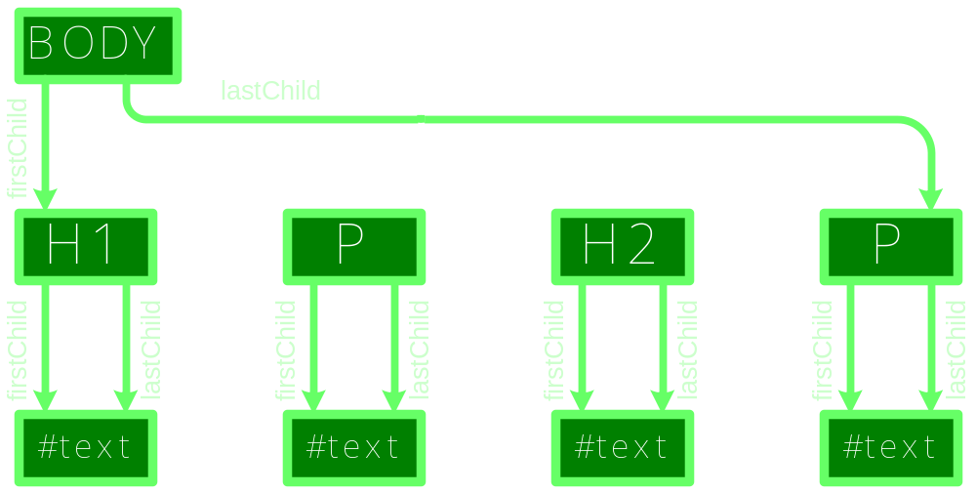
child, sibling, parent

Slide 25
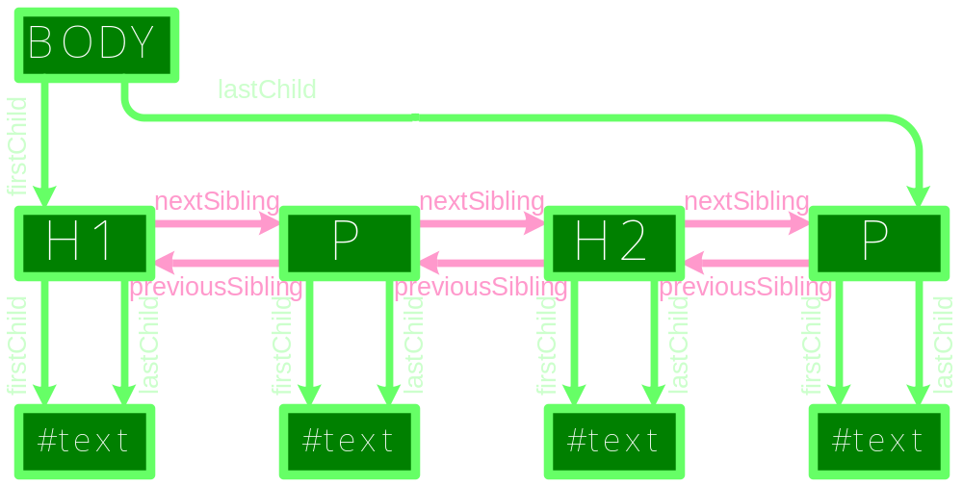
child, sibling, parent

Slide 26
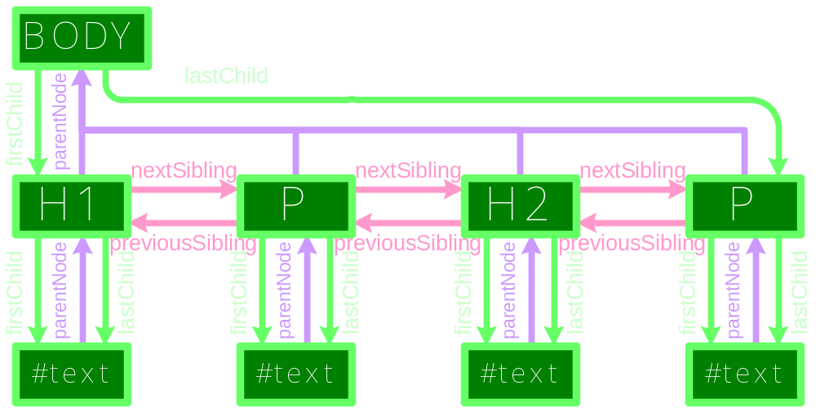
child, sibling, parent

Slide 27
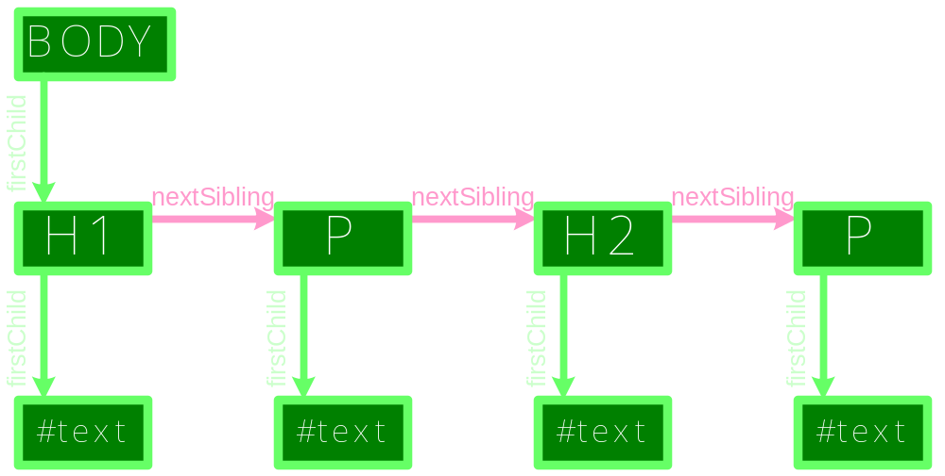
child, sibling, parent

Slide 28
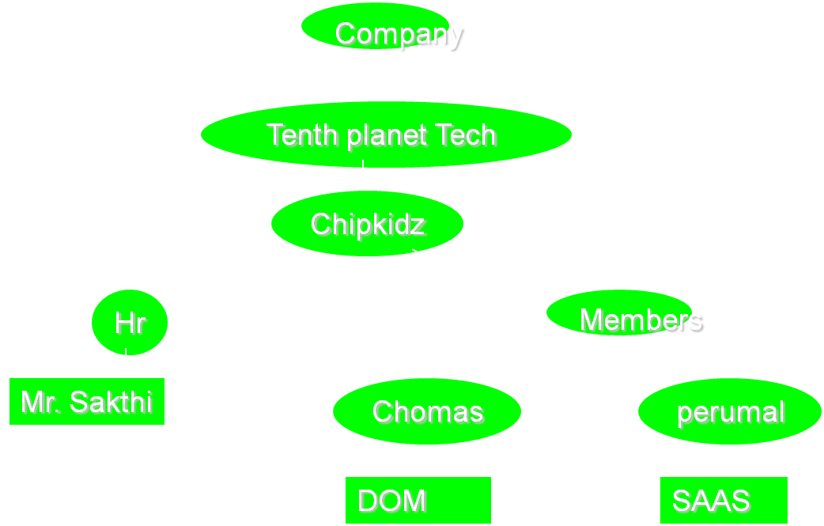
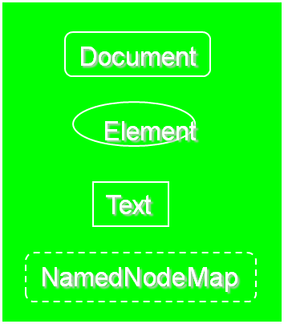
<Company>
<Tenth planet Tech>
<Chipkidz>
<Hr>Mr. Sakthi</Hr>
<Members>
<chomas>DOM
</chomas>
<perumal>SAAS
</perumal>
</members>
</chipkidz>
</Tenth planet Tech> ...
DOM structure model
ID=“BOLD”

Slide 29
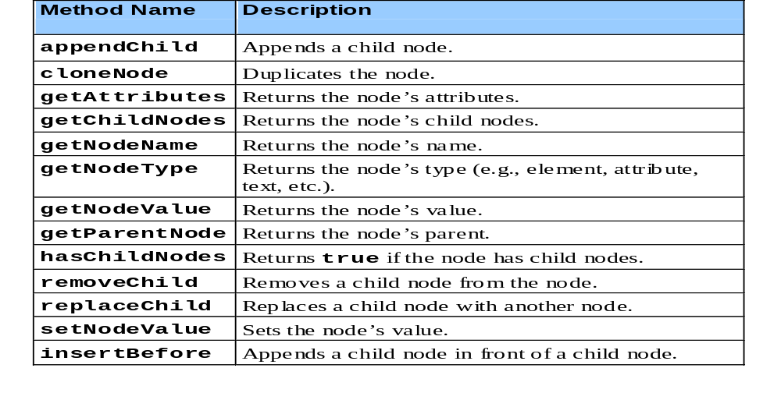
DOM NODE Methods

Slide 30
document
.firstChild
.childNodes[0]
.parentNode
.firstChild
.childNodes[1];

Slide 31
  returns a specific
  element
document
.getElementById()‏
.getElementByTag()‏
  returns an array
  of elements

Slide 32
Example for Changing a node
document
.getElementById(‘BOLD')‏
.firstChild
='bold bit of text';
.nodeValue

Slide 33
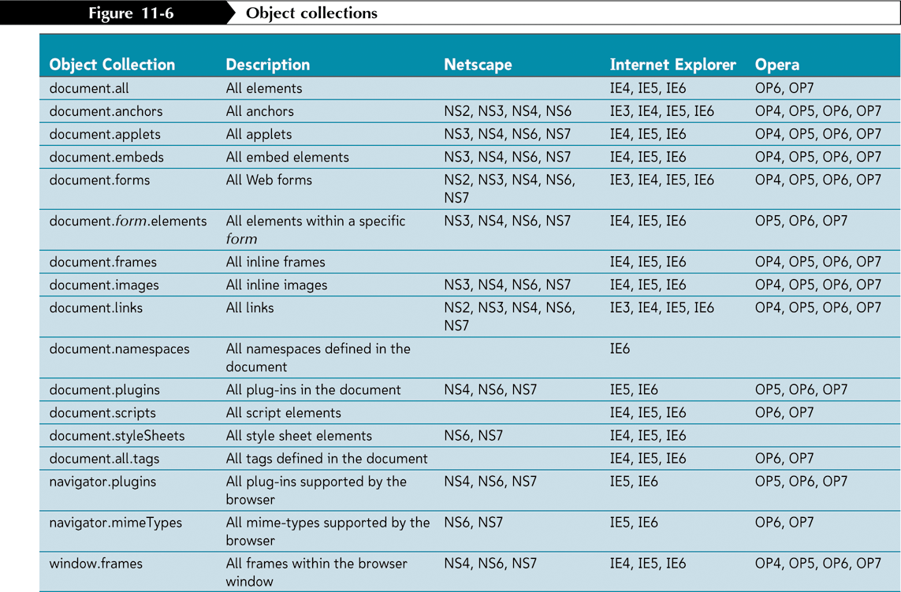
Working with Object Collections
-The Web Document Display in the window

Slide 34
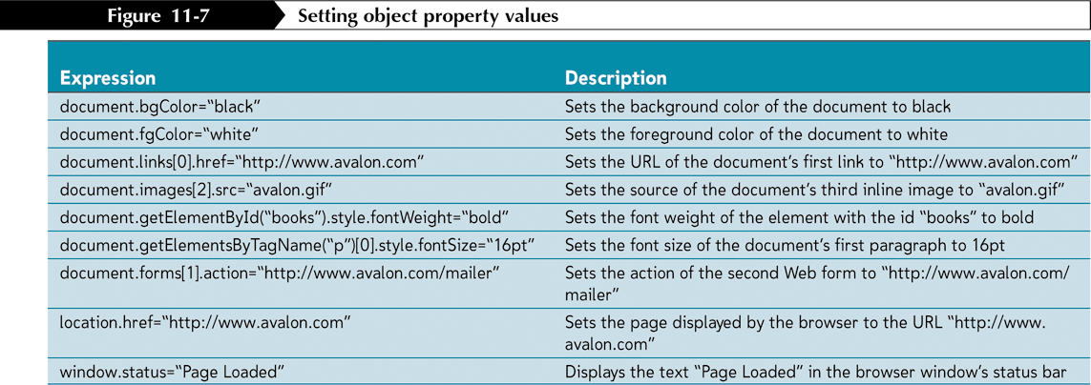
Working with Object Properties

Slide 35
  Example Source Code
  For Document Method
document.body.style.backgroundColor

Slide 36
Examples For Document method
<html>
<head>
<title>Change the Background</title>
</head>
<body>
<script language = "JavaScript">
function background()‏
{ var color = document.bg.color.value;
document.body.style.backgroundColor=color; }
</script>
<form name="bg">
Type the Color Name:<input type="text" name="color" size="20"><br>
Click the Submit Button to change this Background color as your Color.<br>
<input type="button" value="Submit" onClick='background()'>
</form>
</body>
</html>

Slide 37

How To Implement
In
The Blogspot

Slide 38
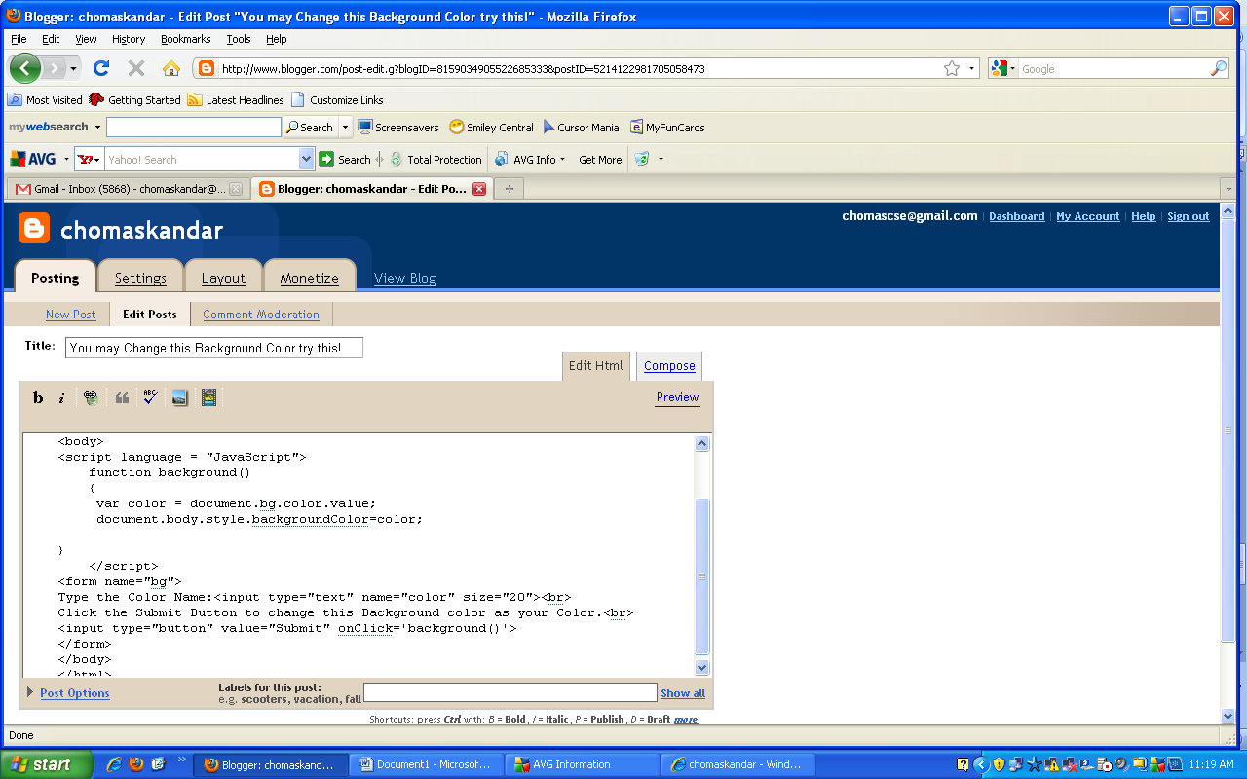

Slide 39
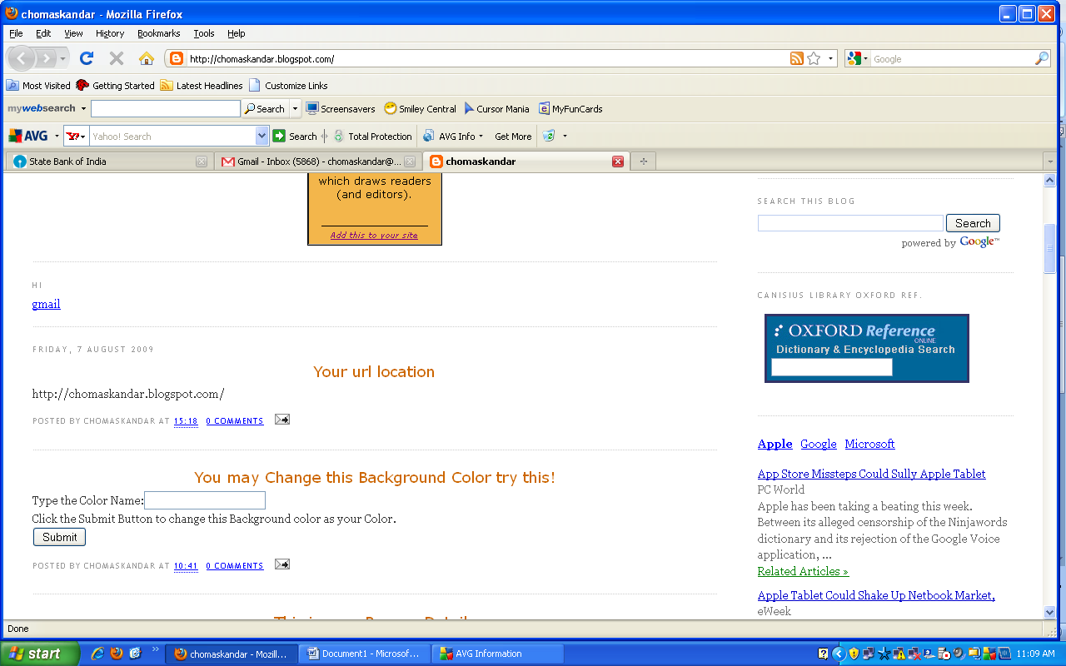

Slide 40
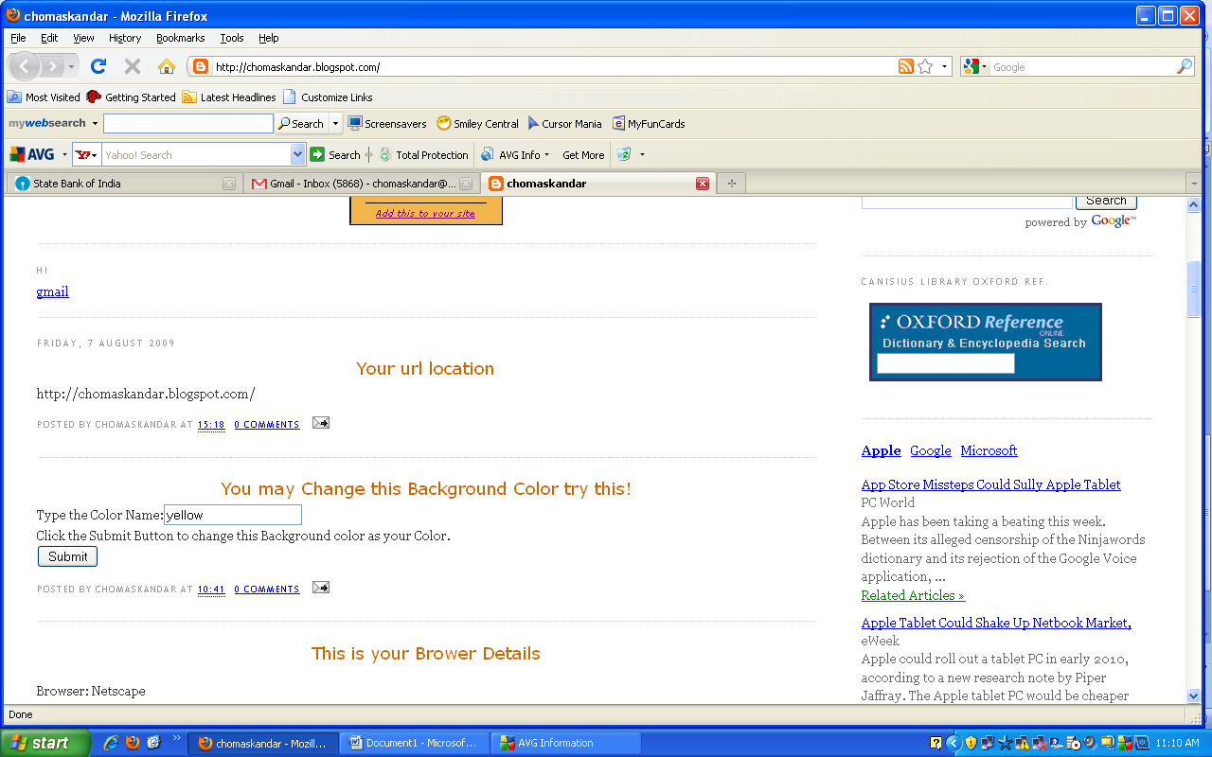

Slide 41
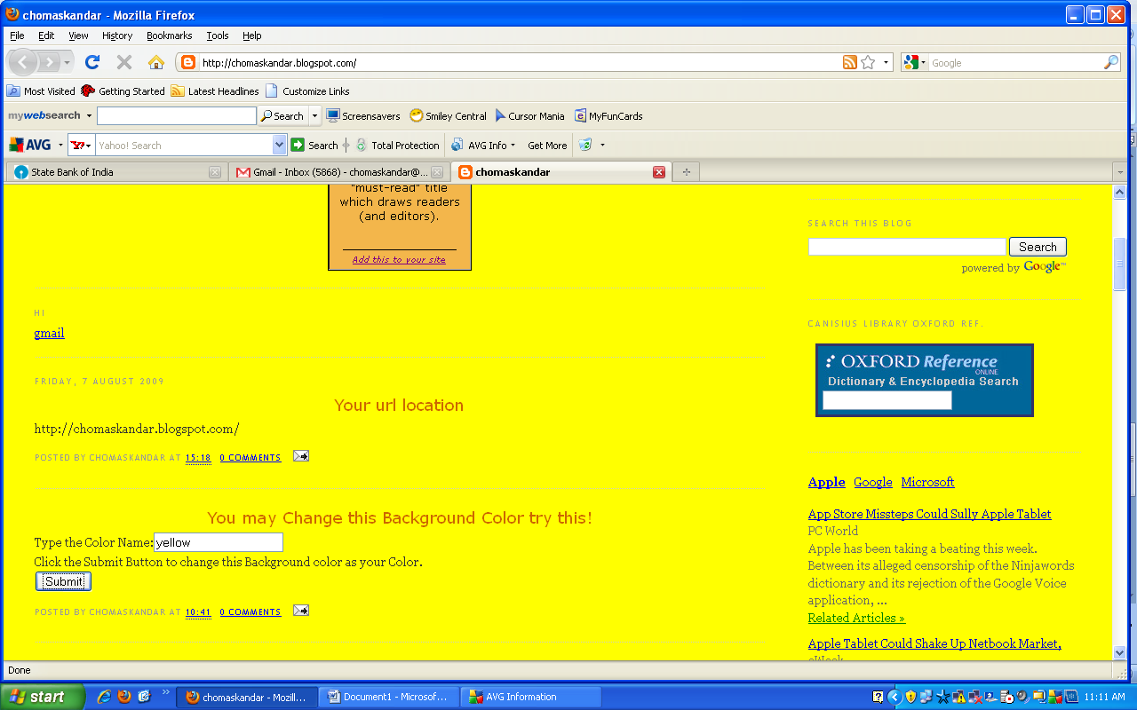

Slide 42
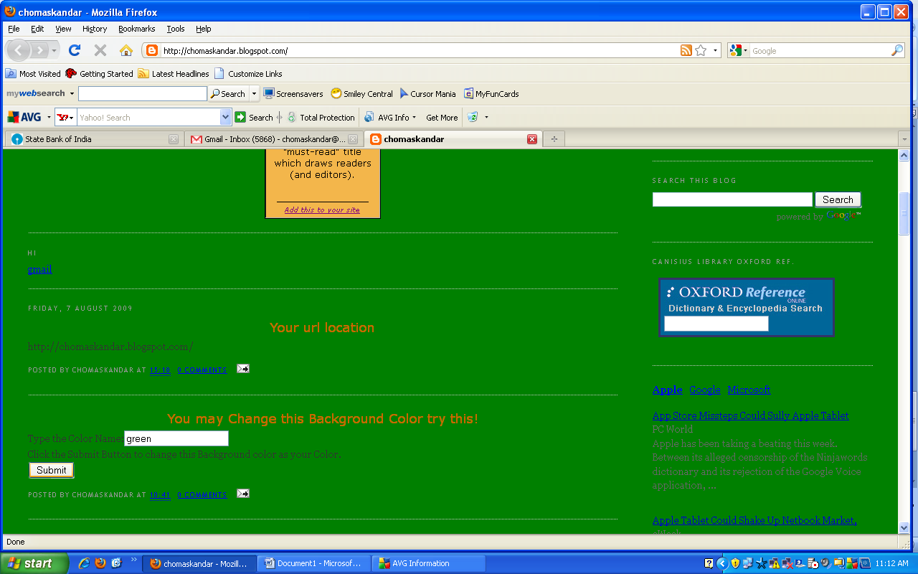

Slide 43
NAVIGATOR

Slide 44
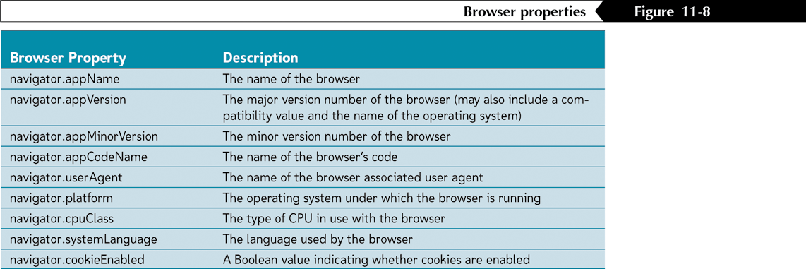
NAVIGATOR :-Some properties are read-only
-The Browser Itself.

Slide 45
  Example Source Code
  For Navigator Method
  navigator.appName
  navigator.appVersion
  navigator.appCodeName
  navigator.platform
  navigator.cookieEnabled

Slide 46
Example For NAVIGATOR
<html><body><script type="text/javascript">
document.write("<p>Browser: ");
document.write(navigator.appName + "</p>");
document.write("<p>Browserversion: ");
document.write(navigator.appVersion + "</p>");
document.write("<p>Code: ");
document.write(navigator.appCodeName + "</p>");
document.write("<p>Platform: ");
document.write(navigator.platform + "</p>");
document.write("<p>Cookies enabled: ");
document.write(navigator.cookieEnabled + "</p>");
document.write("<p>Browser's user agent header: ");
document.write(navigator.userAgent + "</p>");
</script></body></html>

Slide 47
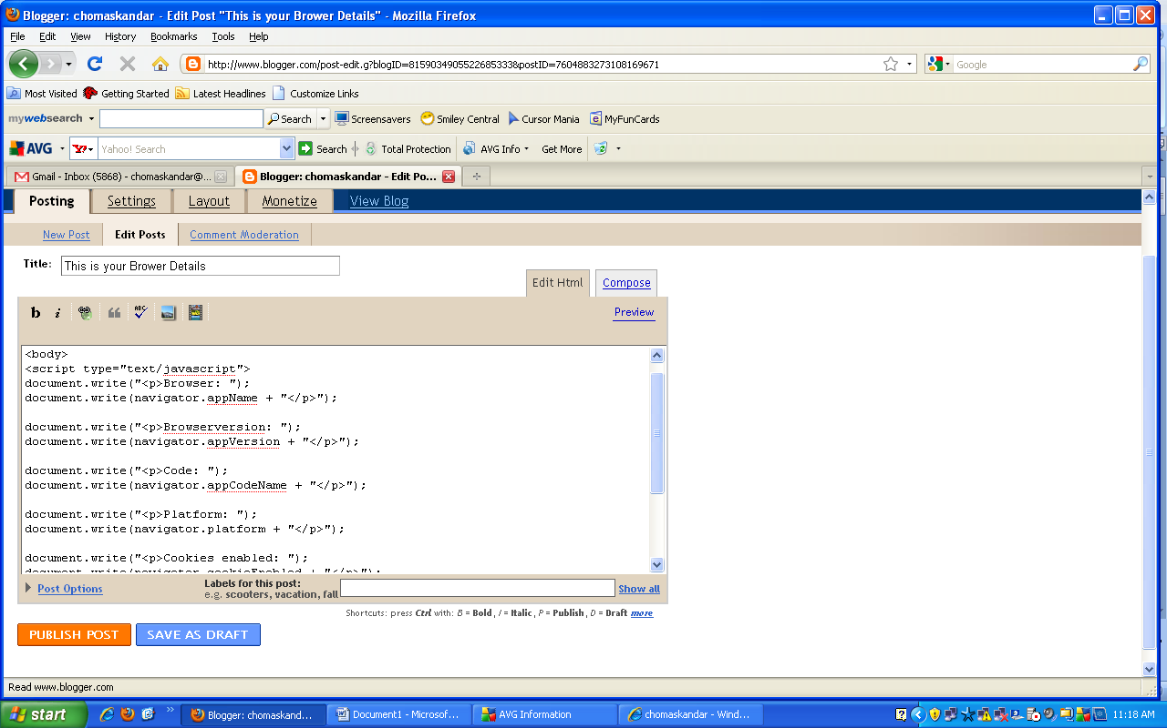

Slide 48

MOZILLA

Slide 49
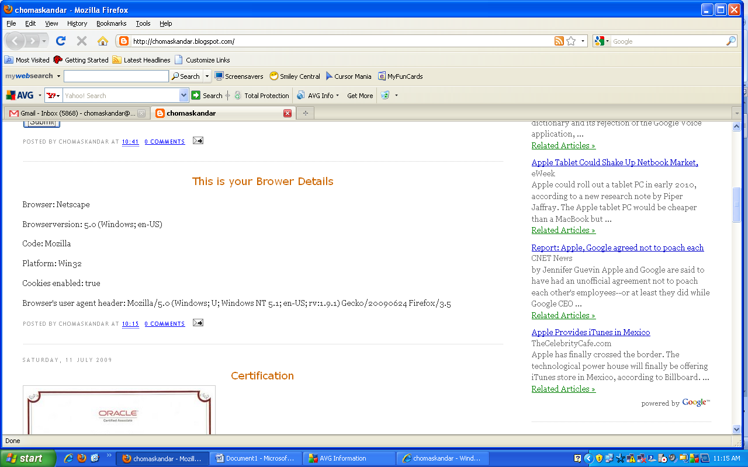

Slide 50

MICROSOFT INTERNET EXPLORER

Slide 51
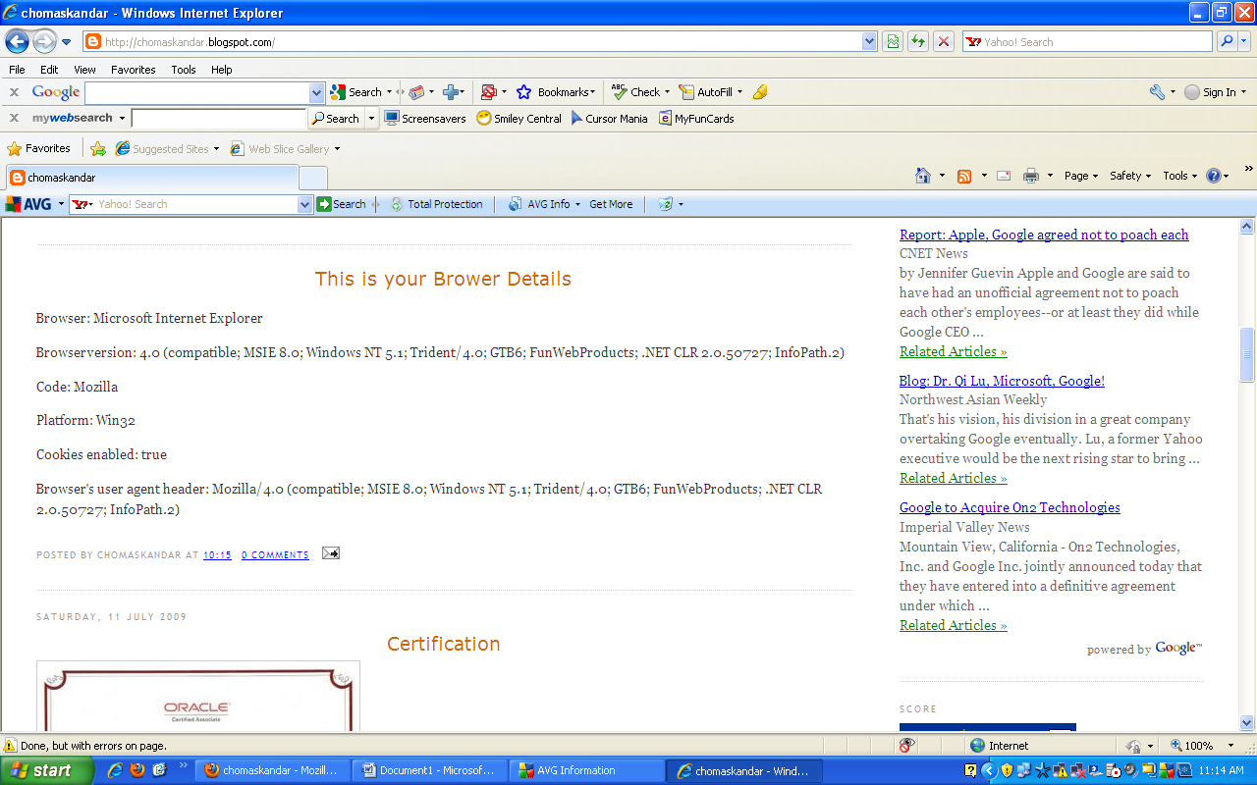

Slide 52

GOOGLE CHORME
GOOGLE CHORME
GOOGLE CHORMEZ

Slide 53
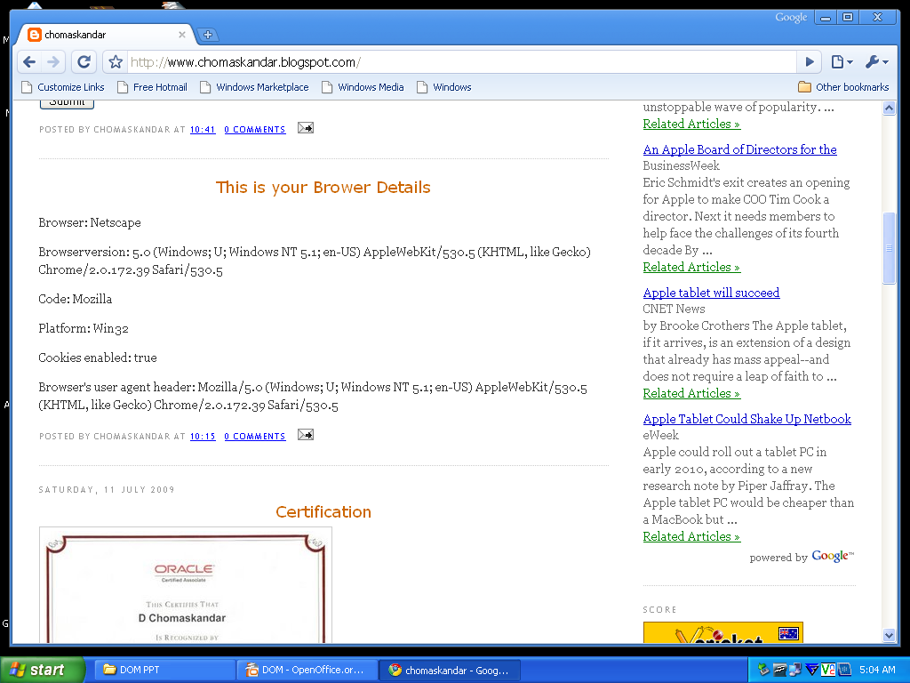

Slide 54
  SOME OTHER METHODS

Slide 55
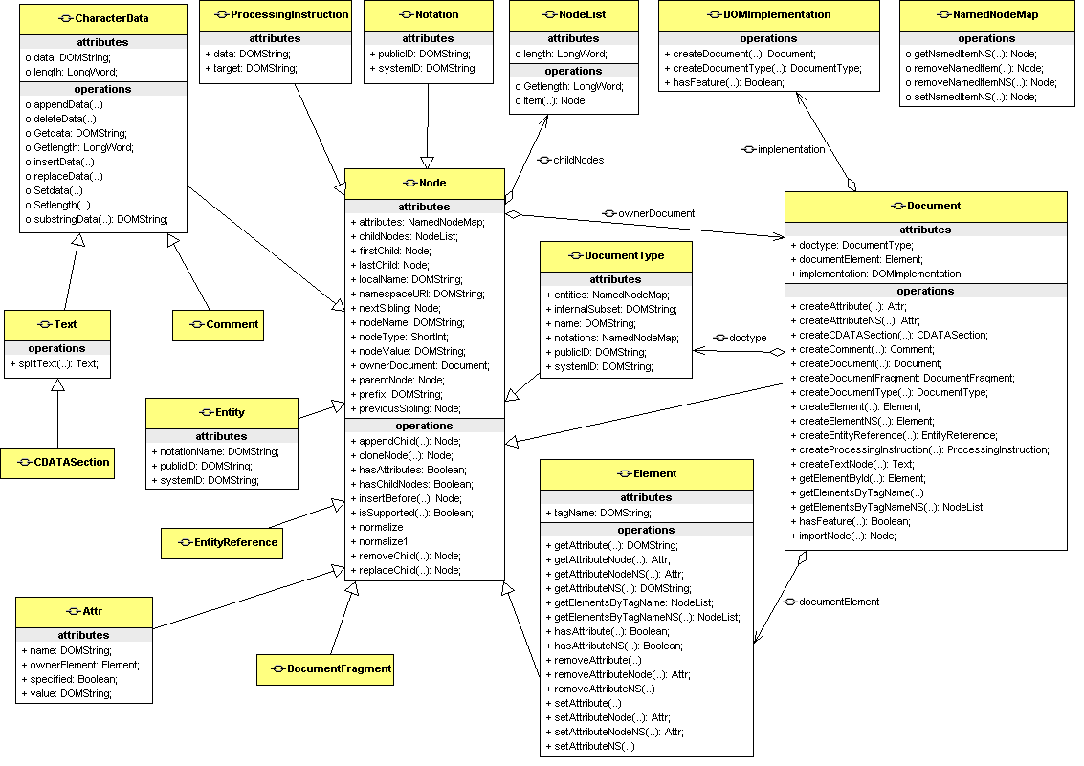

Slide 56
How the DOM Really works?

Slide 57
The Relation Graph
XML+HTML
document
XML
document
Web Client side program (e.g.: JavaScript)‏
Web Server side program (e.g.: ASP)‏
Console program (e.g.: C++, Java)‏
DOM
Output

Slide 58
An Example —
Most Frequently Used Interface, Node
Attributes
Methods
  childNodes
  insertBefore
  nodeName
  replaceChild
  nodeValue
  removeChild
  firstChild
  lastChild
  previousSibling
  appendChild
  nextSiblin

Slide 59
DOM in Programming Languages
Java
C++
C#
VB.Net, etc.

Slide 60
DOM Advantages & Disadvantages

Slide 61
DOM Advantages & Disadvantages
ADVANTAGES
Robust API for the DOM tree
Relatively simple to modify the data structure and extract data
Disadvantages
Stores the entire document in memory
As Dom was written for any language, method naming conventions don’t follow standard java programming conventions

Slide 62
  SAX

Slide 63
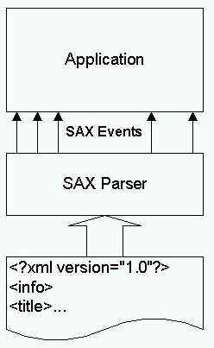
SAX -Simple API for XML
Industry-standard API for parsing XML data.
Unidirectional.
Event-driven.

Slide 64
The History of SAX
Not a W3C recommendation.
Created by members of the xml-dev mailing list, led by David Megginson.
SAX implementations for Java and C++ have been around for a while.
SAX2 is the current API revision .

Slide 65
DOM
OR
SAX

Slide 66
DOM or SAX
DOM
Suitable for small documents
Easily modify document
Memory intensive;Load the complete XML document
SAX -
Suitable for large documents; saves significant amounts of memory
Only traverse document once, start to end
Event driven
Limited standard functions.

Slide 67




Some DOM Supporting Browsers
Konqueror
Opera
Camino
Safari

Slide 68
SUMMARY

Slide 69
Summary
DOM is a tree representation of an XML document in memory
Dom provides a robust API to easily Modify and extract data from an XML document
JAXP provides a vendor –neutral interface to the underlying DOM or SAX Parser

Slide 70
References
www.w3.org/DOM
http://developer.mozilla.org/en/Gecko_DOM_Reference
www.corewebprogramming.com
http://www.w3schools.com

Slide 71
QUESTIONS ?

Slide 72
  chomaskandar@gmail.com
For more Information
http://web2sharing.wordpress.com
For any Queries

Slide 73
THANK YOU

